Slide 1
App architecture without RDBS vs NoSQL drama
Jeff Putz

Slide 3
About me
Live in The OC (Florida version, next door to Walt Disney World).
Working the softwares since 1999-ish.
Diverse experience, from megacorps like Microsoft and Humana to startups and dot-com flameouts.
Currently VP of Product Development and Software Engineering for novi AMS (association management SaaS product).
Been hiring people on and off for the last ten years.
Current career stage: Visio, email and occasionally code.
Decks: https://github.com/jeffputz
jeff@popw.com and on the Twitter @jeffputz

Slide 4
Who is this for
Developers, developers, developers
“Architects” probably get this
Skeptical business folk
This is not an argument about what is more scalable, but rather choosing the right tool (scale is different for SQL vs. NoSQL)
There are good practices to follow for any persistence platform

Slide 5
NEW THING COMES OUT AND YOU BE LIKE
I GOTTA USE THAT BECAUSE I’M AWESOME

Slide 6
About context
Avoid shiny object syndrome at all costs.
Really understand and work through your problem, before you start coming up with solutions.
Context is more than just code, it’s your team, process, budget, skillsets, available time, astrological sign.
For real, this stuff doesn’t apply just to data persistence, it applies to everything we do.

Slide 7
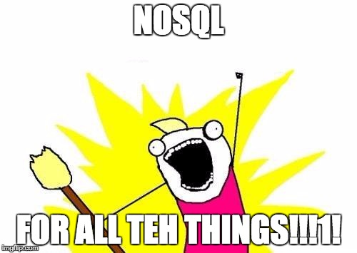
2010

Slide 8
To SQL or not to SQL
Does your data have relationships? Parent/child relationships are the biggest reason for this. Use SQL.
Have unstructured data, data retrieved by a single key, documents, blobs? Use NoSQL if the skillsets allow.
Does your schema change a lot, is querying reasonably specific and are do you have specific throughput targets? NoSQL, but get ready to research your options.
What experience does your team have? SQL is cheaper to support because everyone knows it. Also: SQL can probably do what you need.

Slide 9
What problems does NoSQL solve?
Computationally less expensive, depending on which system.
Crazy throughput, especially for writes, also depending on system.
Potentially higher developer productivity (assuming prior knowledge).
Tons of options, many in managed cloud offerings. Choose from key/value, document, graph, column.
Many are open source, so licensing is not a component of cost.
Simple API’s, usually RESTful, so they’re platform agnostic (though let’s be honest, you can use SQL variants everywhere too).
Ironically, using NoSQL and thinking in the simplest terms is good practice for better SQL.

Slide 10
A quick reality check
You are not Facebook or the Twitter.
Don’t prematurely optimize.

Slide 11

DISAPPROVE GORILLA
DISAPPROVES OF
PREMATURE OPTIMIZATION

Slide 12
The new normal
Most SQL databases can do straight, single-key storage adequately.
Fight the urge to normalize everything.
Sometimes, it’s OK to compose instead of join (an important consideration for NoSQL usage, but also for SQL).
Important: Don’t build schema around object graphs that never have to be interrogated. Just serialize it, drop it in a single field.
Break down what your business need is, and figure out the fastest possible way to get it. Focus on the domain, not the persistence and code mechanisms.
Hybrid solutions are (SQL + table/blob storage, SQL + key/value) are great options provided you can persist in a transactional manner.

Slide 13
SQL sauce: Avoid the join
Aggregate querying is the performance bottleneck sin for the average LOB app. Multiple joins plus averages or sums are bad news.
Think about what physically has to be read from a disk to generate your results.
Create well-defined logic pipelines in your app (not the database!) that recalculate aggregate fields when the relevant data changes, so you don’t have to query it in real time.
One calculation when the data changes is faster than calculating all of it every time!
Notes:
Saw this over and over when working in consulting agency.

Slide 14


Slide 15
Beautifully cloudy days
Azure, AWS, Google have countless options.
SQL Server in the cloud > on-premise SQL (don’t let DBA’s tell you otherwise).
Instrumentation on cloud services is generally excellent (some even make suggestions to better your schema or indexing).
Maintenance and administration is near zero.
Pricing models vary based on a combination of storage and transactional throughput.
Experimentation and prototyping is super cheap, so you can make informed choices.

Slide 16
Real-world anecdotes
SQL: Report storage, tabular data serialized and stored in a single row, rehydrated easily to HTML tables or CSV’s.
NoSQL (table): State management for worker processes.
SQL + NoSQL (Redis): Distributed, two-level cache enabled by messaging.
SQL + Search (AWS, Azure or even Lucene over storage): Fast search results with ID’s to SQL entities.
Table storage fail: Display events in user profile, were out of order because inserts were non-deterministic. SQL was a better choice.

Slide 17
Questions
Decks: https://github.com/jeffputz
jeff@popw.com and on the Twitter @jeffputz
Don’t forget to rate this session!
Mentor and develop each others’ careers
Remember… respect and diversity make us better

